Slide 1
Describing exchange rates with ratio
Understanding multiplicative relationships: fractions and ratio

Slide 2
how to use Oak lessons

Slide 3
I can use ratio to describe exchange rates.

Slide 4
An exchange rate is the rate at which one currency is exchanged for another. The two currencies are in proportion because they have a constant multiplicative relationship.

Slide 5

Describing exchange rates with ratio
Representations of exchange rates
Writing exchange rates as a ratio

Slide 6
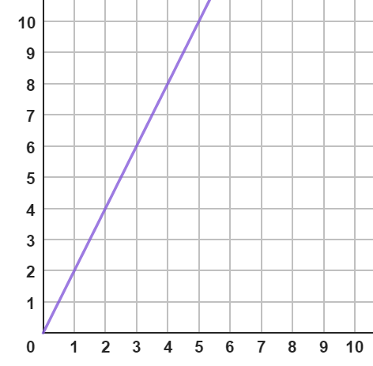
Representations of exchange rates
The relationship between the number of boxes of pens bought and the total cost of the boxes is shown on a graph below:
Does it show a multiplicative relationship?
Cost (£)
It does. As the number of boxes doubles so does the cost.
Number of boxes

Slide 7
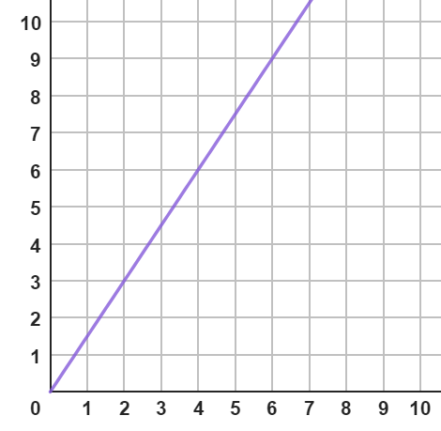
Representations of exchange rates
This graph shows the relationship between 2 currencies used in a computer game.
Does it show a multiplicative relationship?
zags
2 zigs = 3 zags
4 zigs = 6 zags
So, yes it does.
zigs
We could also represent this on a double number line.
0
1
2
3
4
5
6
7
8
9
zag
zig
0
1
2
3
4
5
6

Slide 8
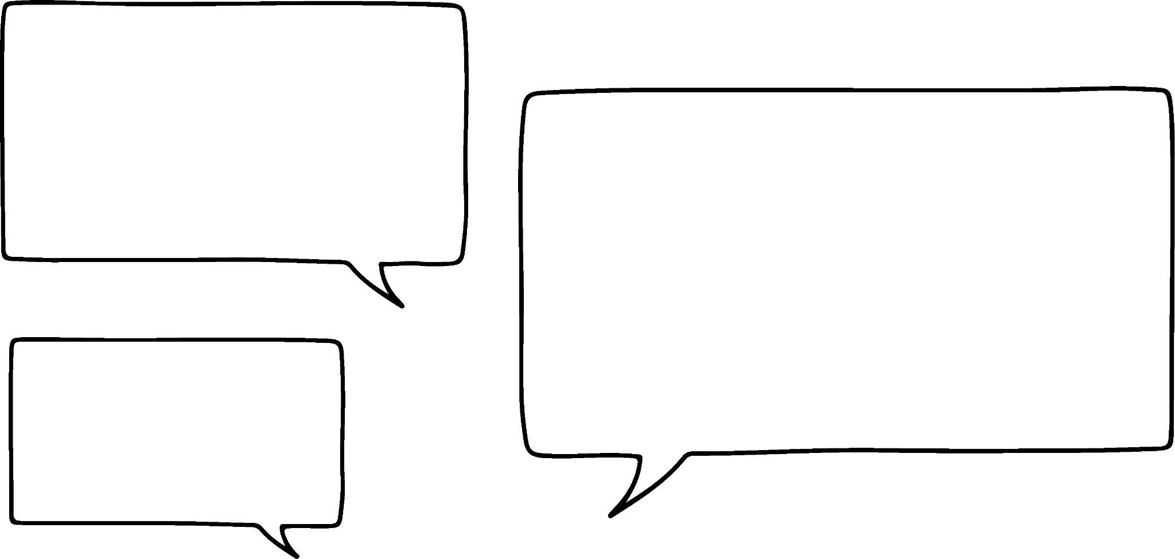


Representations of exchange rates
Izzy and Jun are going on a school trip.
They need to exchange their spending money from pounds into euros.
I’ve got £75, how many euros will I get?
I changed £100 and I got €117.
Izzy
Jun
We could represent this exchange graphically or on a double number line.
Let’s take a look at that.

Slide 9
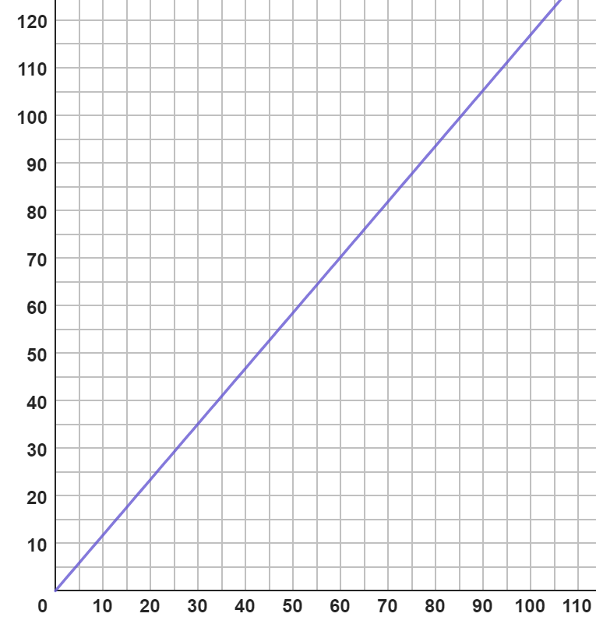
Representations of exchange rates
Often exchange rates are shown graphically.
This is the point we know and used to draw the line.
x
Euros (€)
We could estimate the value of £75.
£75 would be approximately €87.
An alternative representation would be a double number line we will take a look at that now.
Pounds
(£)

Slide 10
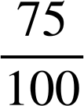
Representations of exchange rates
I’ve got £75, how many euros will I get?
I changed £100 and I got €117.
×
75
100
Izzy
Pounds (£)
Jun
Euros (€)
87.75
117
?
×
Notice using the double number line we are able to find the exact value.
Jun will get €87.75

Slide 11
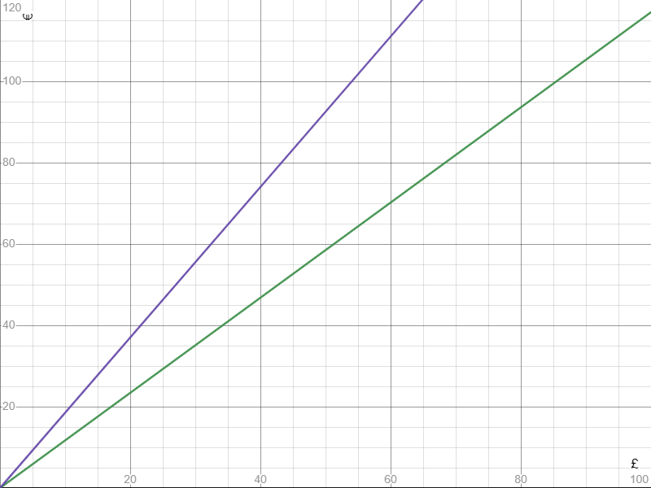
Representations of exchange rates
Exchange rates are always changing.
What would happen to the graph if the exchange rate changed and Izzy got €185?
Would it get steeper?
The higher the exchange rate the steeper the graph.

Slide 12

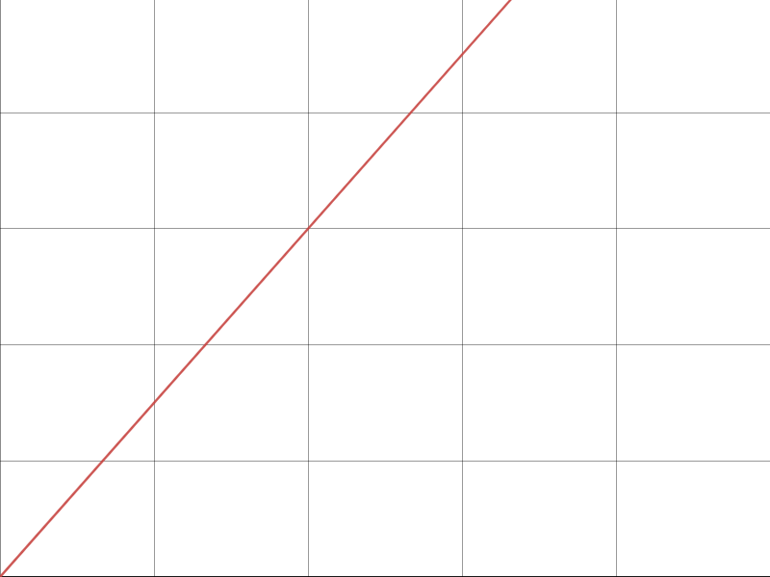
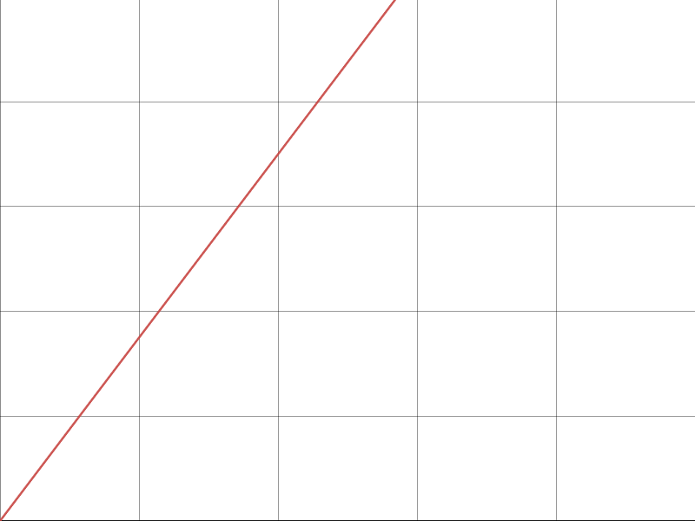
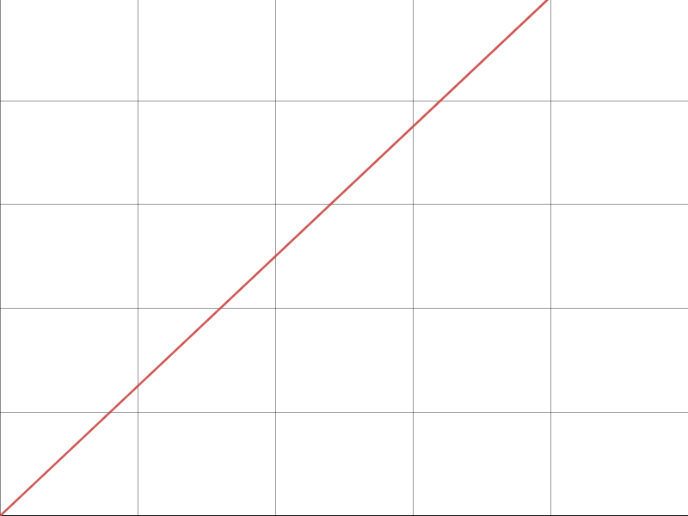
Representations of exchange rates
Given that these are plotted on axes that have the same scale, match each exchange rate to the correct graph.
£100 = $125
£100 = $150
£100 = $175
£100 = $150
£100 = $175
£100 = $125
a
b
c
d
e
f

Slide 13
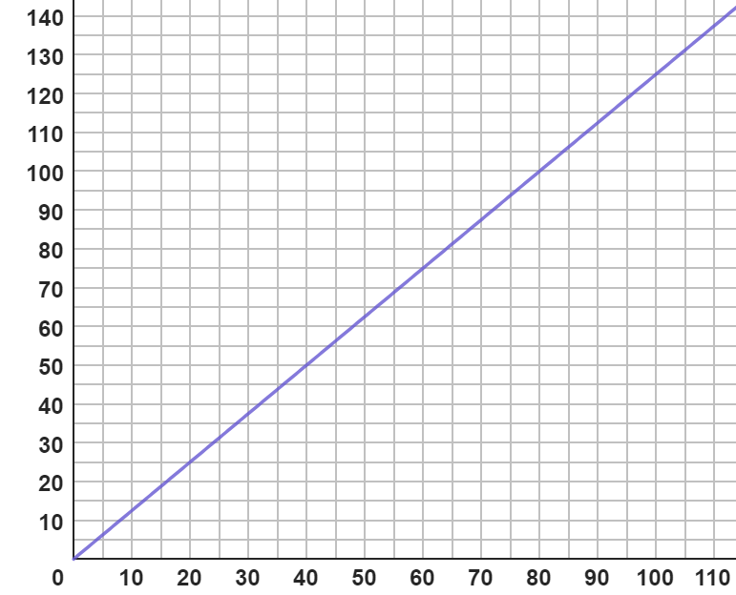
Representations of exchange rates
If we know a conversion of currencies we can draw our own conversion graph.
$
I changed £100 and I got $125.
✖
Izzy
Estimate how many dollars you would get with £60.
You would get approximately $75.
£

Slide 14
Representations of exchange rates
If we know a conversion of currencies we can draw our own conversion graph.
$
I changed £100 and I got $125.
✖
Izzy
Estimate how many pounds you would get with $100.
You would get approximately £80.
£

Slide 15
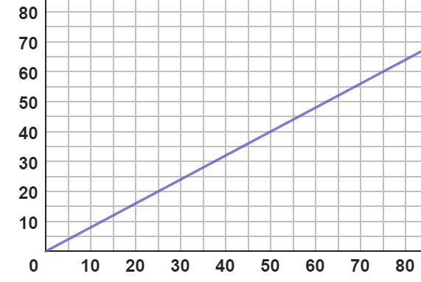
Representations of exchange rates
Spot the mistake.
Use the graph to estimate the number of pounds you would get for $50.
$
Approximately £40.
The lines on the graph shows £50 is approximately $40.
They started on the wrong axis.
£
$50 is approximately £63.

Slide 16
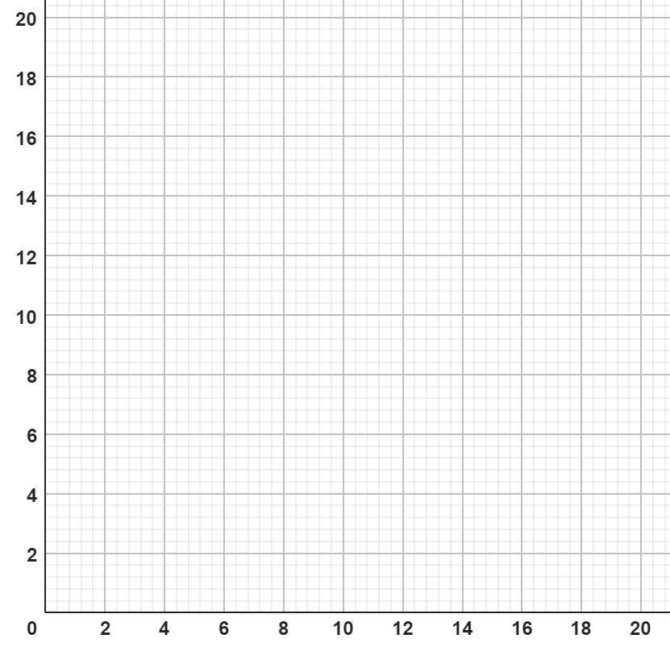
Representations of exchange rates
Draw a graph and estimate the conversions.
a) £10 = $15
$
£8 = $ .
$6 = £ .
£

Slide 17
Representations of exchange rates
Draw a graph and estimate the conversions.
b) £8 = €10
€
£6 = € .
€4 = £ .
£

Slide 18
Representations of exchange rates
Draw a graph and estimate the conversions.
c) £14 = €18
€
£5 = € .
€16 = £ . .
£

Slide 19
Representations of exchange rates
Draw a graph and estimate the conversions.
d) £16 = $18
$
£11 = $ .
$8 = £ .
£

Slide 20
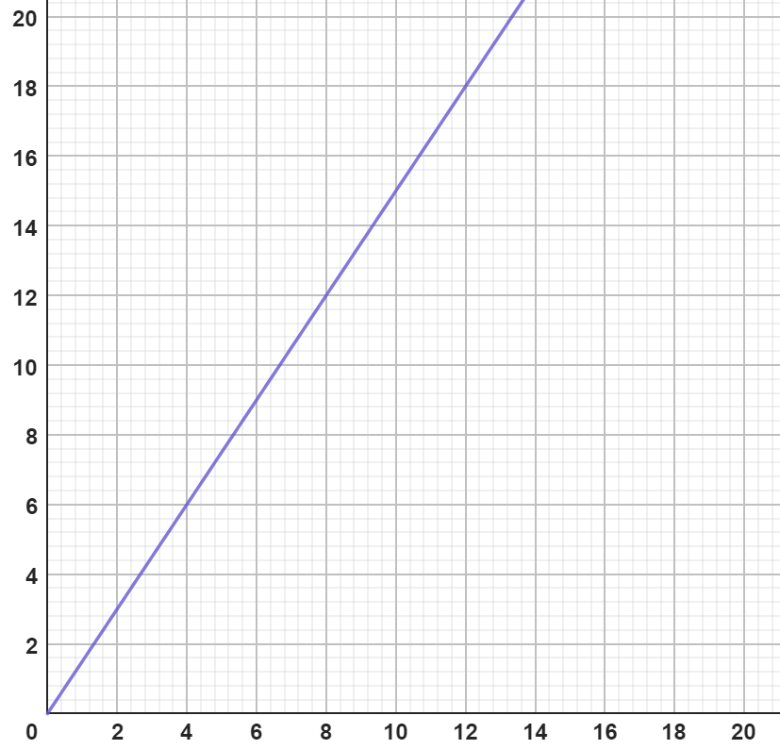
Representations of exchange rates
Draw a graph and estimate the conversions.
a) £10 = $15
$
£8 = $12.
$6 = £4 .
£

Slide 21
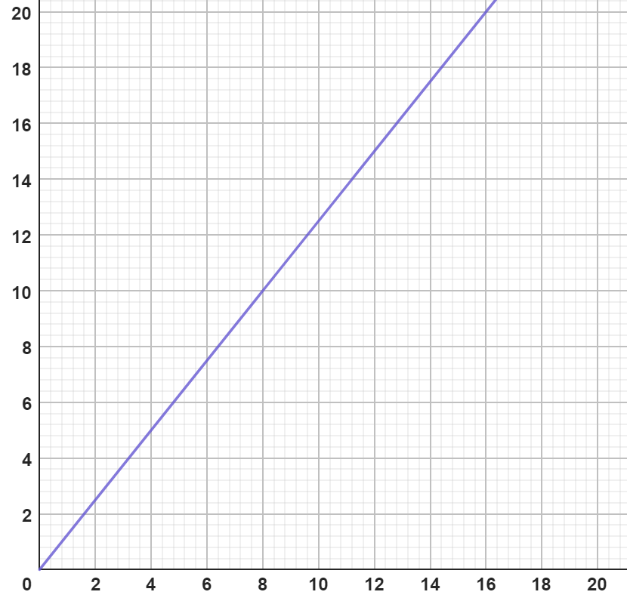
Representations of exchange rates
Draw a graph and estimate the conversions.
b) £8 = €10
€
£6 = €7.20 to €7.80 .
€4 = £3 to £3.40 .
£

Slide 22
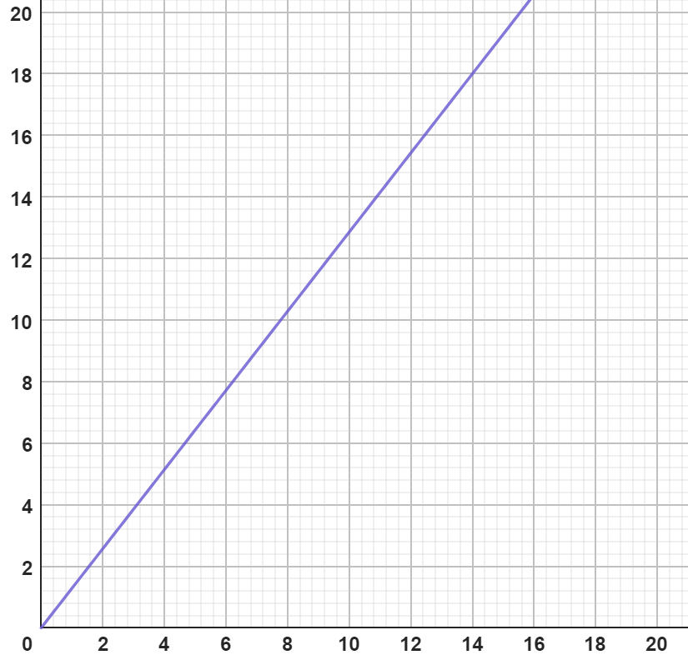
Representations of exchange rates
Draw a graph and estimate the conversions.
c) £14 = €18
€
£5 = €6.20 to €6.80. To
€16 = £12.20 to £12.70 .
£

Slide 23
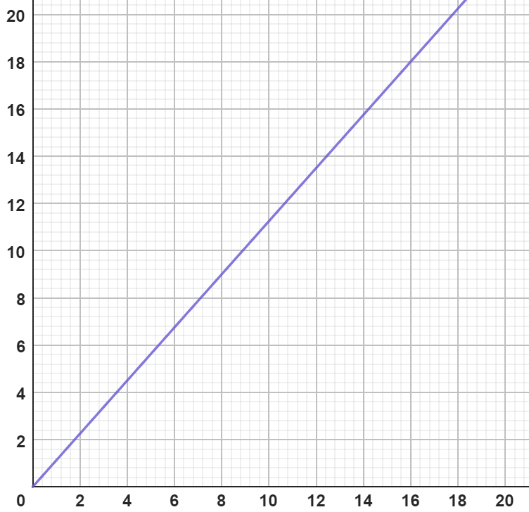
Representations of exchange rates
Draw a graph and estimate the conversions.
d) £16 = $18
$
£11 = $12.20 to $12.70.
$8 = £6.80 to £7.20.
£

Slide 24
Describing exchange rates with ratio
Representations of exchange rates
Writing exchange rates as a ratio

Slide 25


Writing exchange rates as a ratio
Andeep, Jun and Sofia are going on holiday.
They all exchange some pounds for euros.
Who got the best deal?
I changed €120 and I got £100.
I received €90 for £60.
I received €30 for £20.
Andeep
Jun
Sofia
How can we compare these?
We can write them as ratios.

Slide 26
Writing exchange rates as a ratio
€ : £
120 : 100
€ : £
30 : 20
€ : £
90 : 60
Andeep:
Jun:
Sofia:
Has this helped?
No, we need to create equivalent ratios where one of the currencies is the same in all three.
I changed €120 and I got £100.
I received €90 for £60.
I received €30 for £20.
Andeep
Jun
Sofia

Slide 27
Writing exchange rates as a ratio
€ : £
120 : 100
€ : £
30 : 20
€ : £
90 : 60
Andeep:
Jun:
Sofia:
They are all multiples of 10 so we could find how many euros each of them would have received for £10.

Slide 28
Writing exchange rates as a ratio
€ : £
120 : 100
Andeep:
÷ 10
÷ 10
12 : 10
? : 10
Andeep received €12 for every £10. Jun and Sofia both get €15 for every £10. Therefore, Jun and Sofia both got the best deal.
€ : £
30 : 20
Jun:
÷ 2
÷ 2
15 : 10
? : 10
€ : £
90 : 60
Sofia:
÷ 6
÷ 6
15 : 10
? : 10

Slide 29
Writing exchange rates as a ratio
If they had not all been multiples of 10 we would need to create equivalent ratios where a currency is set to 1

Slide 30
Writing exchange rates as a ratio
€ : £
120 : 100
Andeep:
When we have the ratio in the form 1 : n this is the exchange rate.
÷ 100
÷ 100
1.2 : 1
? : 1
€ : £
30 : 20
Jun:
÷ 20
÷ 20
1.5 : 1
? : 1
€ : £
90 : 60
Sofia:
÷ 60
÷ 60
1.5 : 1
? : 1

Slide 31
Writing exchange rates as a ratio
We also could have worked out the exchange rate of euros to pounds.

Slide 32
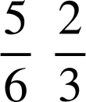
Writing exchange rates as a ratio
€ : £
120 : 100
Andeep:
When we have the ratio in the form 1 : n this is the exchange rate.
÷ 120
÷ 120
1 :
1 : ?
€ : £
30 : 20
Jun:
÷ 30
÷ 30
1 :
1 : ?
€ : £
90 : 60
Sofia:
÷ 90
1 :
÷ 90
1 : ?

Slide 33
Writing exchange rates as a ratio
Here are the exchange rates we have just calculated.
Andeep:
€ : £
1.2 : 1
Jun:
Sofia:
€ : £
1.5 : 1
€ : £
1.5 : 1
€ : £
1 :
€ : £
1 :
€ : £
1 :
Earlier you said Jun & Sofia had the best deal. But now Andeep’s is better!
What do you think about Izzy’s comment?
This is why it is important we know what the ratio is telling us.
Izzy

Slide 34
Writing exchange rates as a ratio
€ : £
1.2 : 1
This means for every £1 you get €1.2.
You get more euros for each pound.
€ : £
1.5 : 1
This means for every £1 you get €1.5.
€ : £
1 : 0.83
This means for every 83p you get €1.
Each euro costs you more here.
€ : £
1 : 0.67
This means for every 67p you get €1.

Slide 35

Writing exchange rates as a ratio
£ : €
0.78 : 1
£ : €
0.87 : 1
is a better deal than
Each euro costs more.
Each euro costs less.

Slide 36
Writing exchange rates as a ratio
The exchange rate for pounds to Australian dollars is:
£1 : $1.92
£ | $
1 | 1.92
120
£ | $
1 | 1.92
120 | 230.40
× 120
× 120
I have £120 spending money for my holiday. How many dollars will I get?
Andeep

Slide 37
Writing exchange rates as a ratio
The exchange rate for pounds to Australian dollars is:
£1 : $1.92
£ | $
1 | 1.92
 | 48
£ | $
1 | 1.92
25 | 48
I didn’t spend all of my money. I have brought home $48. How much will I have after I have converted it back into pounds?
× 1.92
÷ 1.92
Andeep

Slide 38
Writing exchange rates as a ratio
Spot the mistake.
£1 : €1.15
Use this exchange rate to convert €46 into pounds.
£ | €
1 | 1.15
46 | 52.90
× 46
× 46
The 46 was €46 so should have been in the right column under 1.15.

Slide 39
Writing exchange rates as a ratio
Find the missing values in the following tables given the exchange rate in the top row.
a)
b)
c)
£ | €
1 | 1.15
280
$ | £
1 | 0.79
50
£ | ¥
1 | 185
15
d)
€ | £
1 | 0.9
 | 22.50
e)
£ | ¥
1 | 185
 | 2312.50
f)
£ | $
1 | 1.25
 | 108.75

Slide 40

Writing exchange rates as a ratio
2) Andeep is comparing prices of sunglasses in the UK, the USA and France.
Rank the following from cheapest to most expensive.
£1 : $1.25
£1 : €1.20
£45.00
$57.00
€54.24

Slide 41
Writing exchange rates as a ratio
Find the missing values in the following tables given the exchange rate in the top row.
a)
b)
c)
£ | €
1 | 1.15
280 | 322
$ | £
1 | 0.79
50 | 39.50
£ | ¥
1 | 185
15 | 2775
d)
€ | £
1 | 0.9
25 | 22.50
e)
£ | ¥
1 | 185
12.50 | 2312.50
f)
£ | $
1 | 1.25
87 | 108.75

Slide 42
Writing exchange rates as a ratio
2) Andeep is comparing prices of sunglasses in the UK, the USA and France.
Rank the following from cheapest to most expensive.
£1 : $1.25
£1 : €1.20
£45.00
$57.00
€54.24
£ | $
1 | 1.25
45.60 | 57
£ | €
1 | 1.20
45.20 | 54.24
In order from cheapest to most expensive: UK, France & USA.

Slide 43
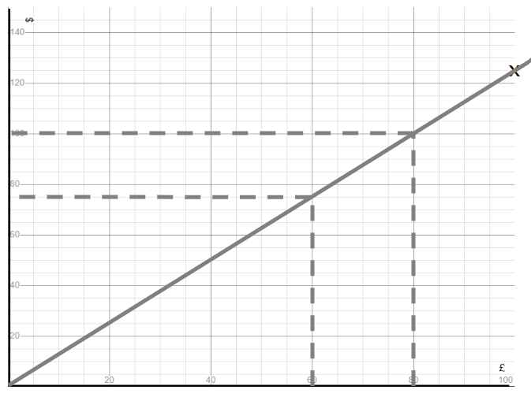
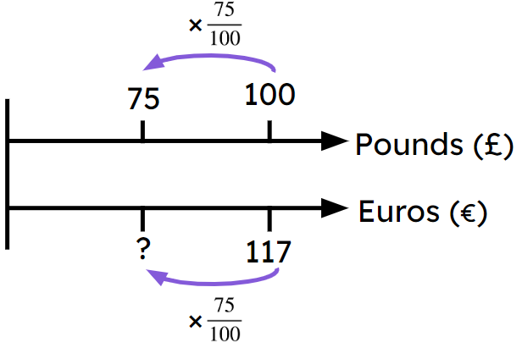
Describing exchange rates with ratio
Exchanges rates can be represented graphically.
E.g.
Exchange rates can be represented on a double number line.
E.g.
Any exchange rate can be shown as a ratio. E.g. £1 : $1.25
This can be used to estimate conversions.

Slide 44

© Oak National Academy 2023.
Produced in partnership with Mathematics in Education and Industry.
Licensed on the Open Government Licence v3.0, except where otherwise stated. See Oak terms and conditions.

